Slide 1
JD Consumer-Behaviour Data Analysis
制作人：
Cashmere Alin
Enrico Rusliem
Oliver asante

Slide 2


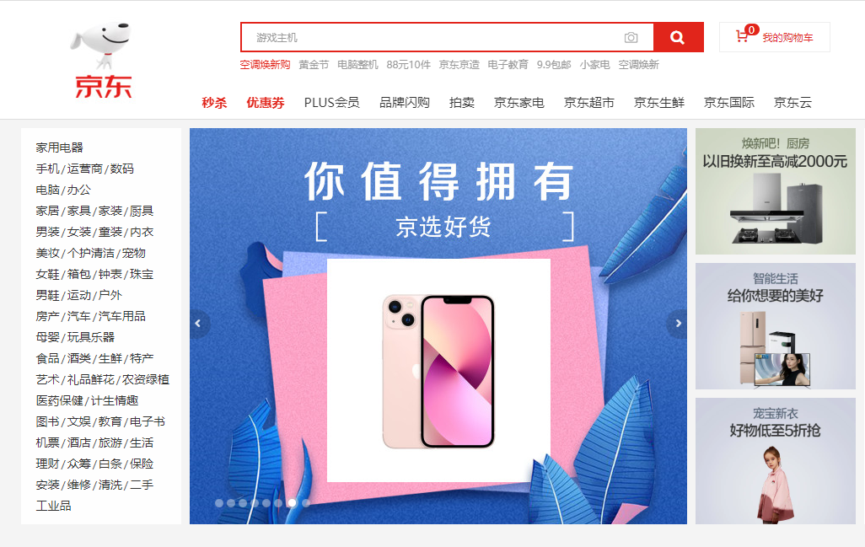

Contents
一、Overview of Project and Instructions
二、Data Origin/Sources
三、Data Processing
四、Data Analysis
1、Time Dimension
2、User Dimension
3、Product Dimension
4、Store Dimension

Slide 3
Project Overview
Background
As a well-known domestic e-commerce platform, Jingdong has maintained rapid development over the years, while precipitating hundreds of millions of users and accumulating massive data, how to find out the rules from historical data, efficiently solve customer actual problems, improve customer shopping physical examination, and achieve precision marketing is a problem that the platform attaches great importance to.
Requirements
According to the data information from merchants, products and users, through data analysis, find the factors that affect user consumption, so as to obtain ways to increase the number of orders.

Slide 4
Data sources
Sources 。。。
Content
From February 1 to April 15, 2018, a total of 183828 pieces of data were collected, including user information, brand, store information, etc.

Slide 5
Data Processing
Data Cleaning Delete null values in age bands and member cities The U data corresponding to the gender field was deleted
Data on age bands and a very small number of categories in membership tiers have been deleted
There are many empty values at the store registration time, and the blank values are removed when analyzing the store information
Data Sorting
Sort into: 日期、年、月、日、小时、周
Names with a smaller number of categories in brands and product categories have been consolidated The negative number that appears in the store rating is converted to 0

Slide 6
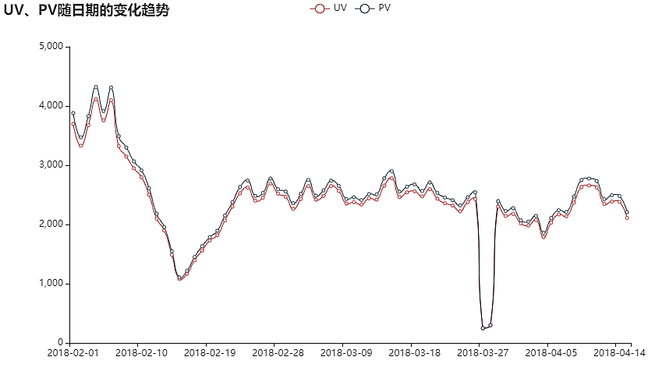
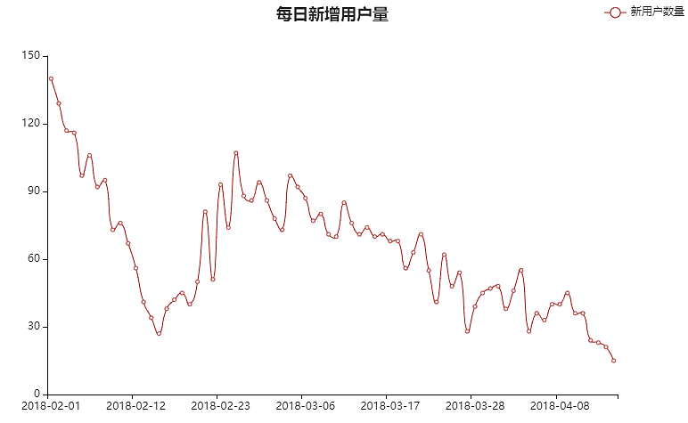
Data Analysis
Time Dimensions
The trend of UV, PV and new users added by date in the figure above is known: 1、Before February 6, the number of UV, PV, and new users was relatively high, and then slowly declined, until February 15, and then slowly increased. Analysis: This situation is mainly due to February 15 is the Spring Festival, February 14 Valentine's Day, shopping is in a saturated state, coupled with the suspension of some express delivery, resulting in UV, PV, new users declined, indicating that the holiday can prompt a large number of users to place orders. 2、On March 27, UV and PV showed a cliff-like low peak on March 28, and immediately returned to normal on March 29, and then fluctuated normally. Analysis: It may be a data error or a technical problem with the platform within two days, making the user unable to log in, indicating that the platform needs more maintenance and bringing a better experience to the user. 3、The number of new users has been declining since mid-March. Analysis: Maybe the platform has not done a good job of accurately pulling new products, and the promotion effect is not good.

Slide 7
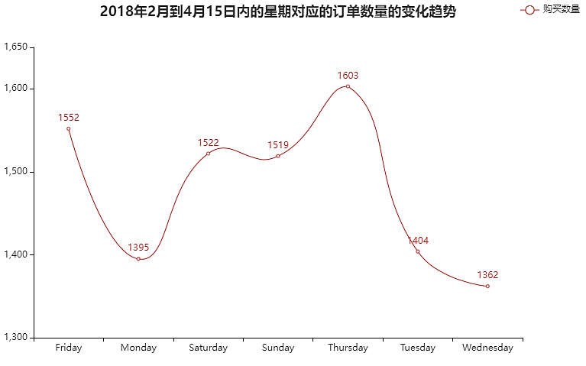
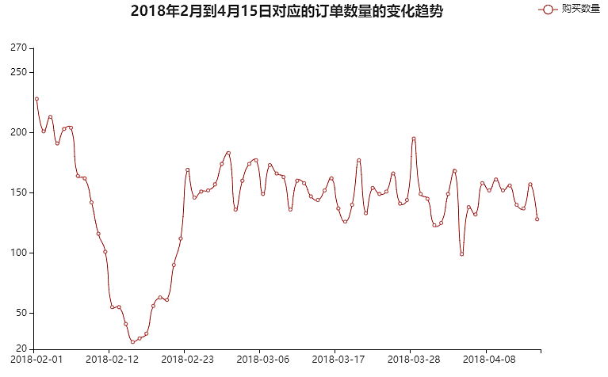
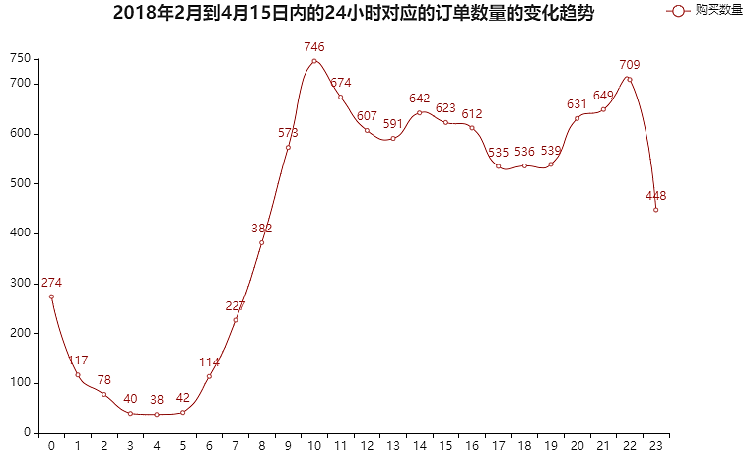
From the perspective of week, the most orders are placed on Thursday, the number of orders placed on Friday, Saturday and Sunday is similar, and the orders are less on non-weekend days, and the least on Wednesday. From the time of day, there is a peak of orders at 10 a.m. and 10 p.m., and from 2 p.m. to 4 p.m. and from 8 p.m. to 10 p.m., the order volume also shows a peak. Analysis: Thursday is usually the time when office workers start to get tired from work, Friday is close to the holiday, users will have the desire to buy, Thursday orders are the most, may be related to the return of logistics to normal after the Spring Festival, the end of office workers' holidays. 10 a.m. and 2 to 4 p.m., and 8 p.m. to 10 p.m. are the hours when users are active.
Data Analysis
Time Dimension
It can be seen that the sales volume before the Spring Festival was very high, due to the partial suspension of the Spring Festival and logistics, sales fell seriously, and then with the normal logistics and the end of the Spring Festival, sales gradually increased, and finally fluctuated steadily.

Slide 8
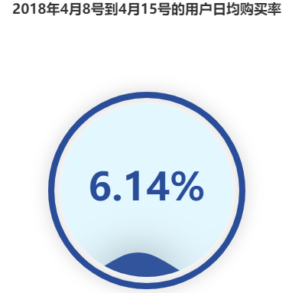
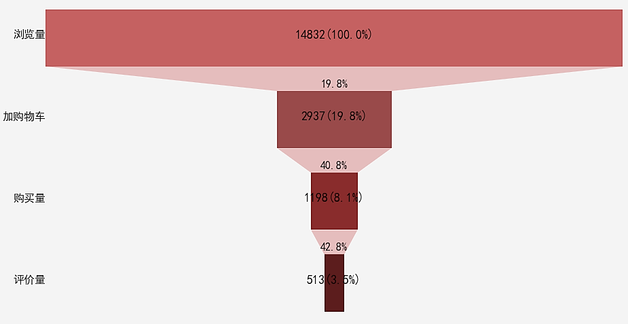
Data Analysis
From page viewing—> favorites—> order—> evaluation: The conversion rate of each step to the previous step is 19.8%, 40.8%, 42.8% The conversion rate of PageView page visits for each step and first step is 19.8%, 8.1%, and 3.5% 1. From the above figure, we can see that the conversion rate of users from browsing to adding to shopping cart is 19.8%, from browsing to purchase is only 8.1%, the conversion rate is very low, and the average daily purchase rate is only 6.14%. 2. The conversion rate from additional purchase to purchase is okay, with 40.8%. 3. From purchase to evaluation, the conversion rate is 42.8%. Analysis: The conversion rate of browsing to the additional purchase is low, indicating that most of the products recommended by Jingdong may not be liked or required by the user, and the customer who joins the shopping cart has a relatively strong desire to buy, and the user has the desire to evaluate after purchasing.
Time Dimension
2018年4月8日到4月15日用户的行为转化率

Slide 9
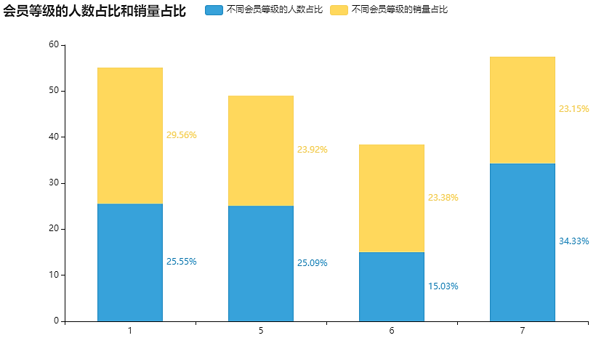
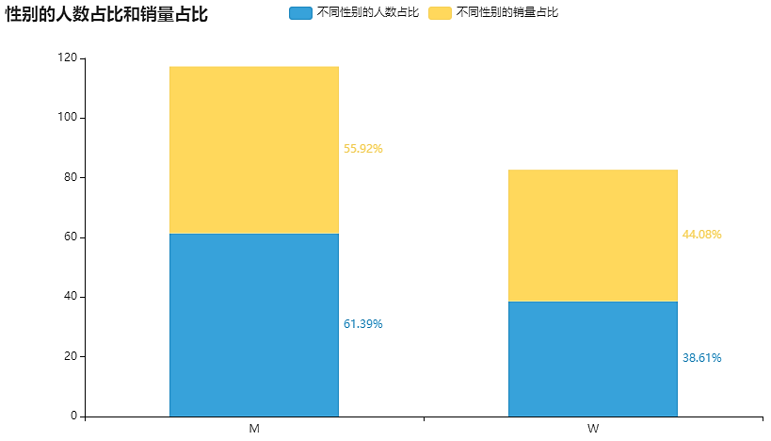
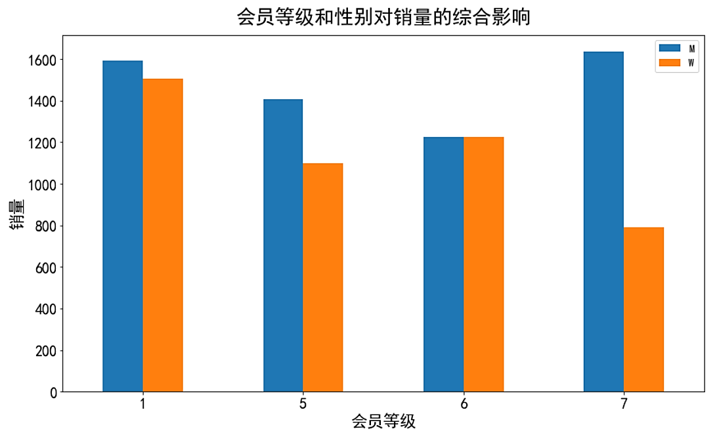
Data Analysis
The membership level of 7 has the most users, but the corresponding sales are the least, of which men buy twice as many as girls; The number of users with membership level 1 is second, sales are first, and the number of purchases by men and women is almost equal; There is not much difference in the number of purchases made by male and female users at levels 5 and 6. Analysis: The purchase level of membership level 1 is the highest, the purchase level of female users at level 7 is the worst, and the purchase volume of male users is almost higher than that of women, but the gap is not very large.
User dimensions
The number of men is slightly higher, almost twice the number of female users, but the sales of men and women are similar. Analysis: Because Jingdong started with electronic products, there will be more male users, but the consumption of men and users is not high.

Slide 10
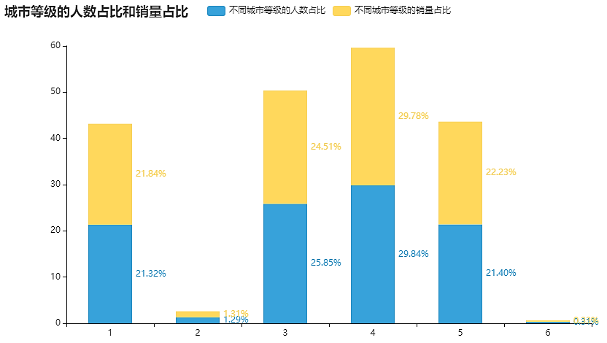
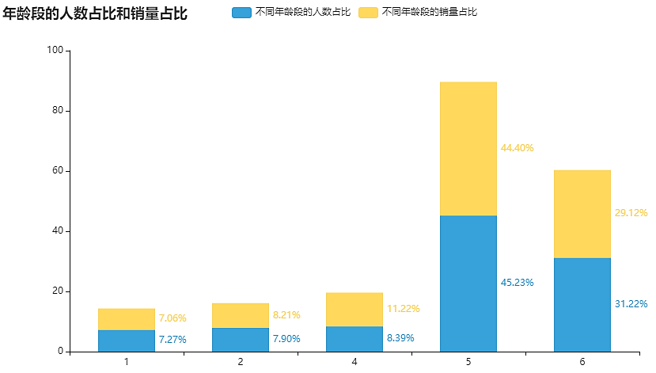
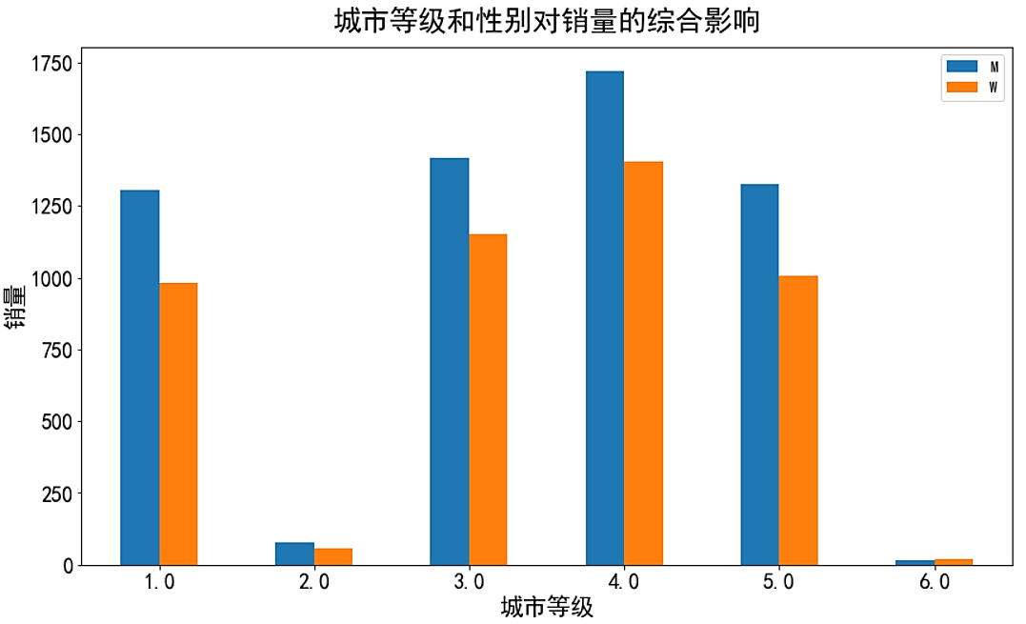
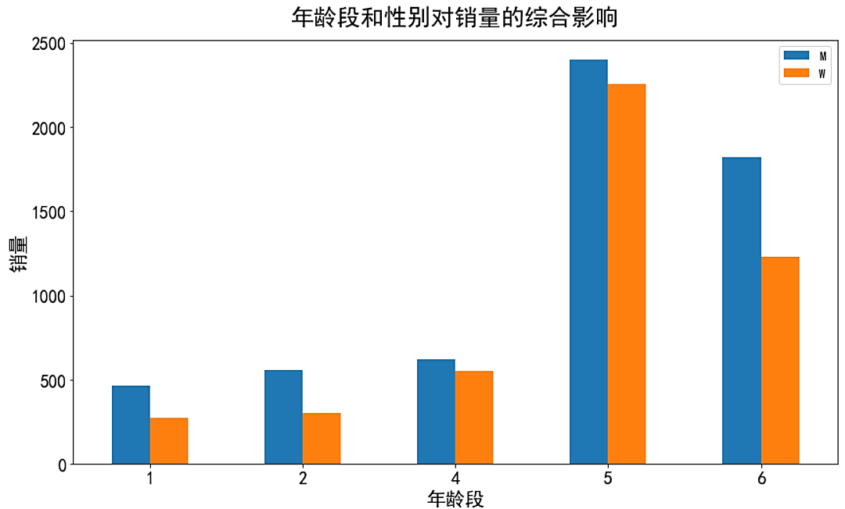
Data Analysis
User Dimensions
In the city level and age group, the corresponding sales volume of more users is also high, the number of people and sales in the city level is 4, and the corresponding purchase volume of men and women is also the largest, followed by the city level 3, the number of people in the city level 2 and 6 is very low; The number of people and sales in the age group is 5, and the corresponding number of purchases by men and women is also the largest, followed by age 6, the number of people and sales in the age group 1, 2, and 4 is very low. Analysis: Urban level 4 and age group 5 have the highest purchase levels, and male users have higher purchases than women, but the gap is not large.

Slide 11
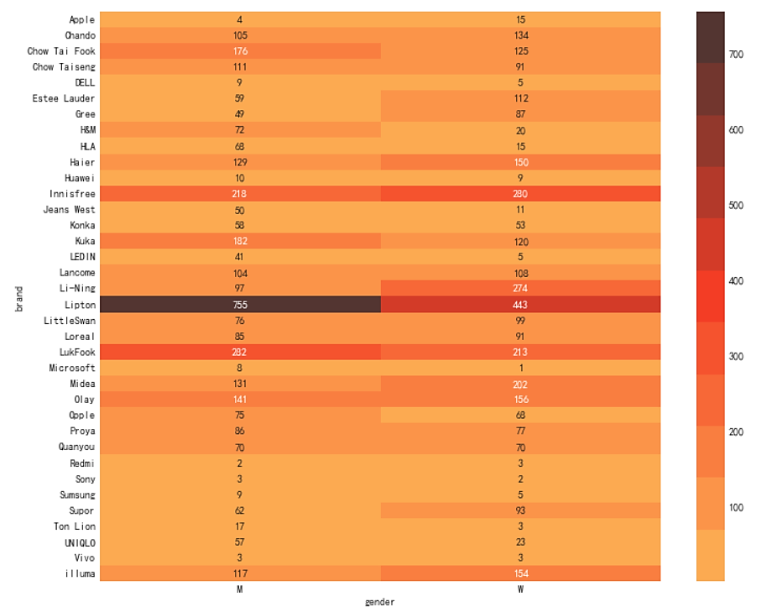
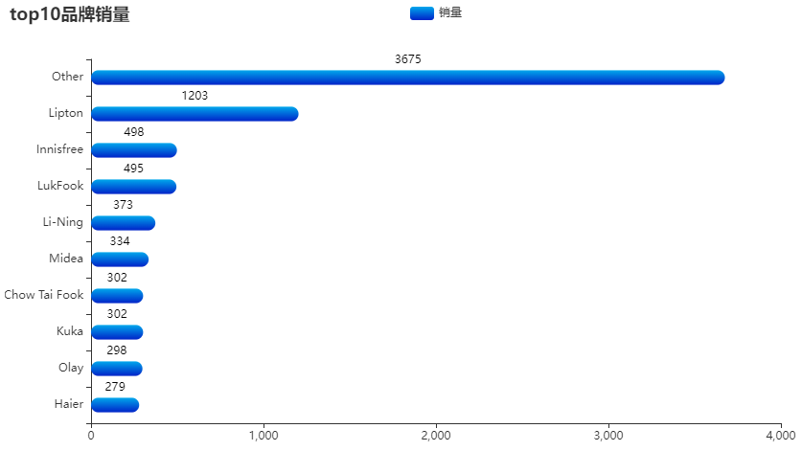
Data Analysis
品牌和性别对销量的影响
Product Dimension
Among the brands purchased by users, the user's favorite is Liption: Lipton tea brand, and the most popular brands for men are Liption, LukFook: Luk Fook jewelry brand, Innisfree: innisfree cosmetics brand; Women's favorite purchases are Liption, Innisfree, and Li-Ning. Analysis: The Lipton tea brand is the most popular, with the same level of consumption between men and women.

Slide 12
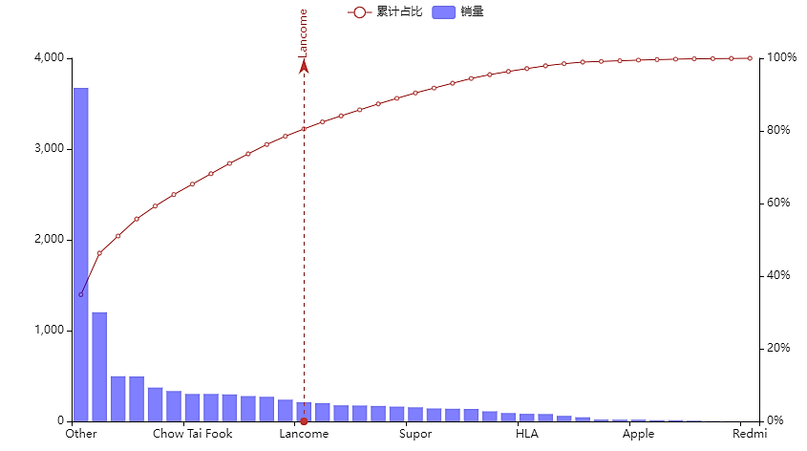
Data Analysis
Product Dimension
Brand Concentration
It can be seen from the figure that the cumulative sales of the top 13 brands just exceed 80% of the sales of all brands (a total of 37 types of brands) 13/37=35.13%, basically in line with the 8020 principle, and the corresponding classifications of the 13 brands are mainly food, clothing, cosmetics, jewelry, and household appliances. Other brands contain many brands, which have a certain error in brand concentration. Analysis: The brands promoted by the platform have relatively high purchases.

Slide 13
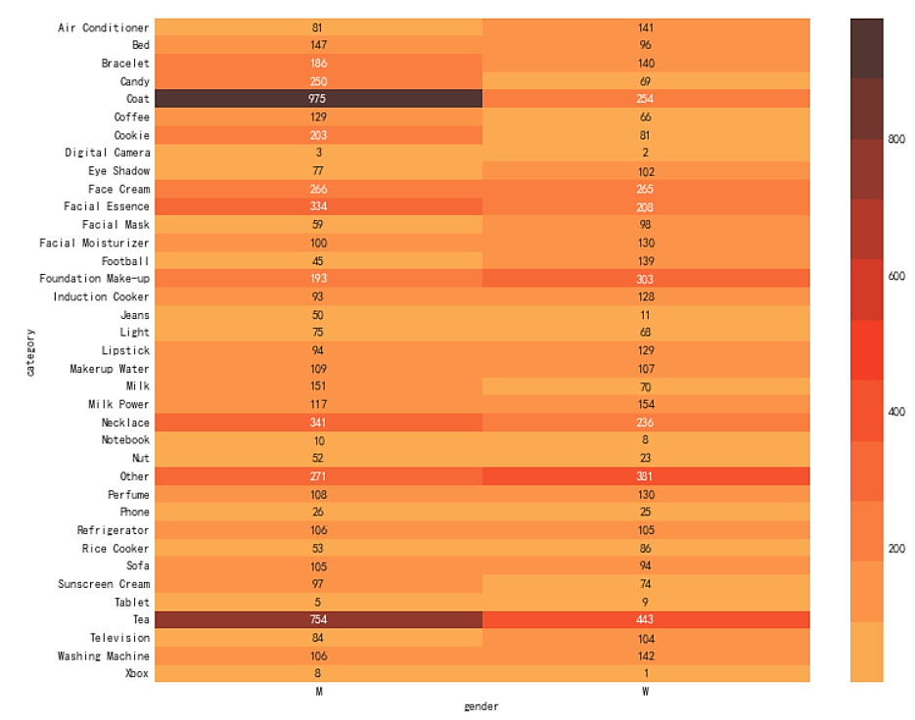
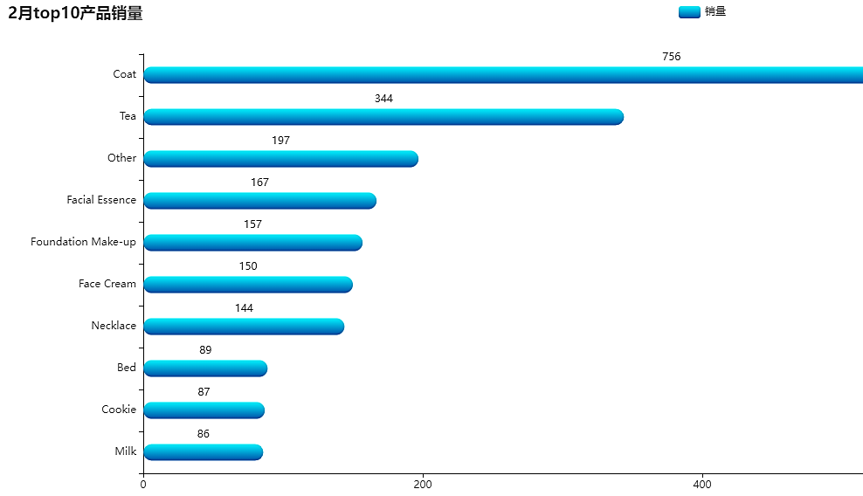
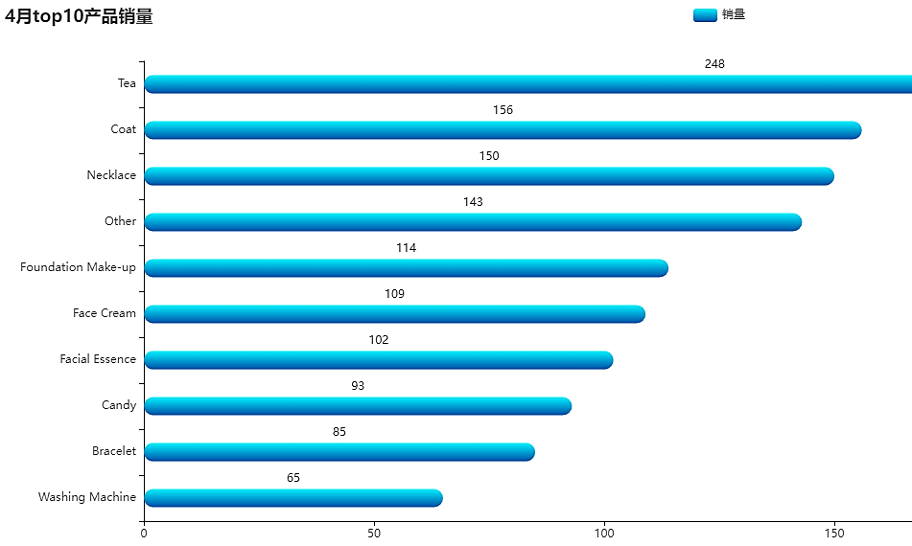
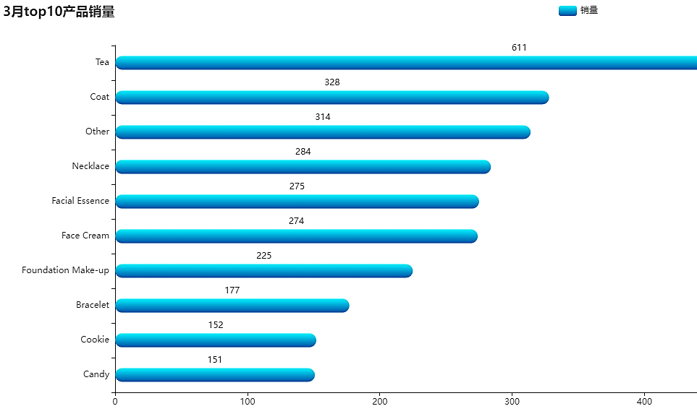
Data Analysis
产品类别和性别对销量的影响
Product Dimension
The top three products in February are Coat, Tea, facial essence, the top three in March and April are Coat, Tea, Necklace, and the most popular products for male users are Coat coats, tea tea, necklace necklaces, facial essence skin care essence; The most common purchases by female users are tea tea, foundation make-up foundation, face cream cream, and coat coat. Analysis: The products with the best repurchase are Coat, Tea, and the high sales of coats may be affected by the season, and the skin care awareness of male users is enhanced.

Slide 14
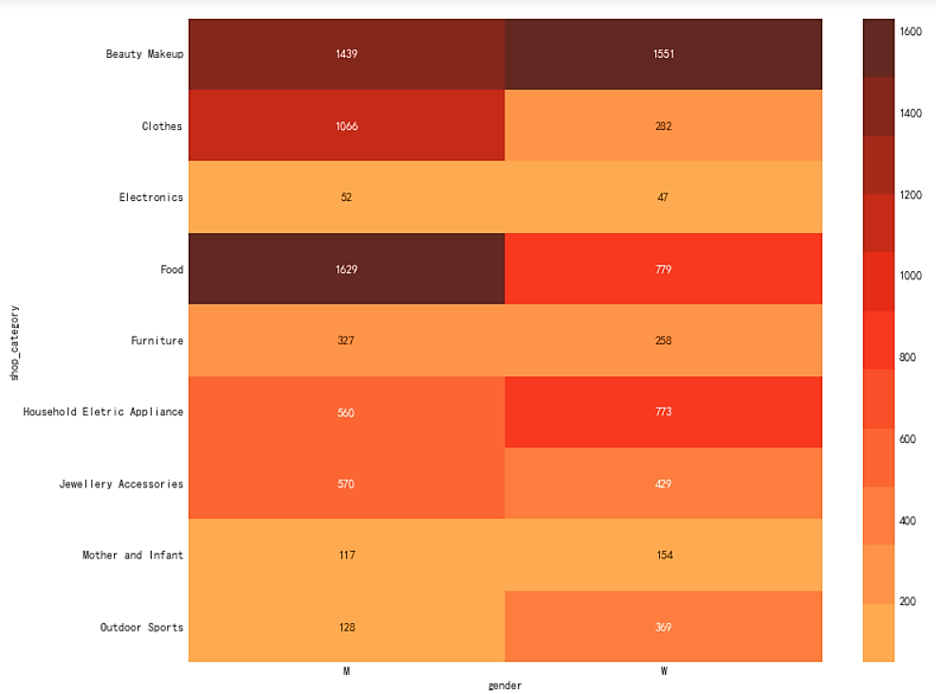
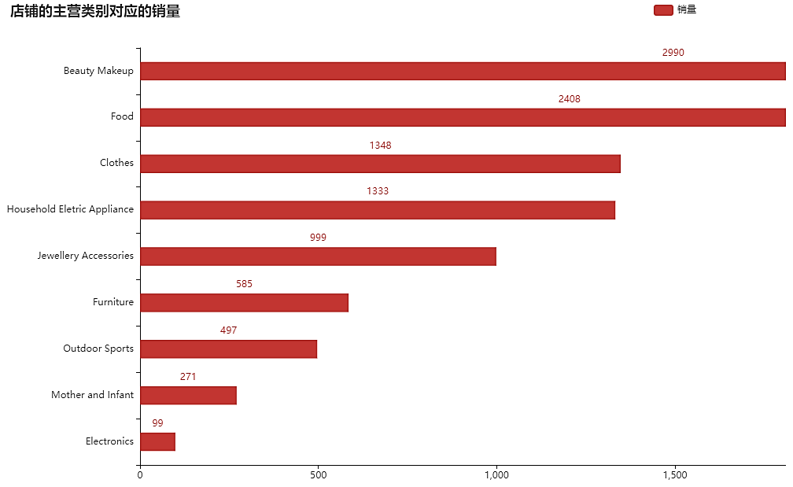
Data Analysis
店铺主营类别和性别对销量的影响
Store Dimension
Among the main categories of the store, beauty makeup, food, and clothing are the most popular. Male users, more purchasing behavior is food, beauty, clothes, female users, more purchase behavior is beauty, food, Household Eletrical Appliance household appliances. Analysis: Beauty, food, clothing stores have the most sales, which is also related to the brand sales of these categories, the more brand sales, the more sales the store.

Slide 15
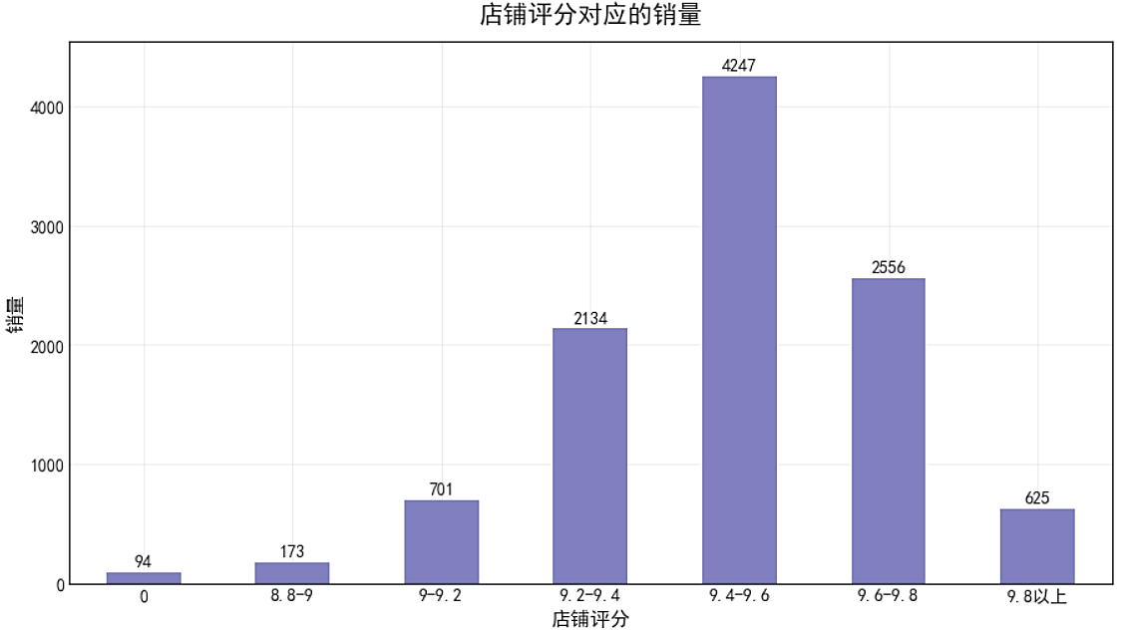
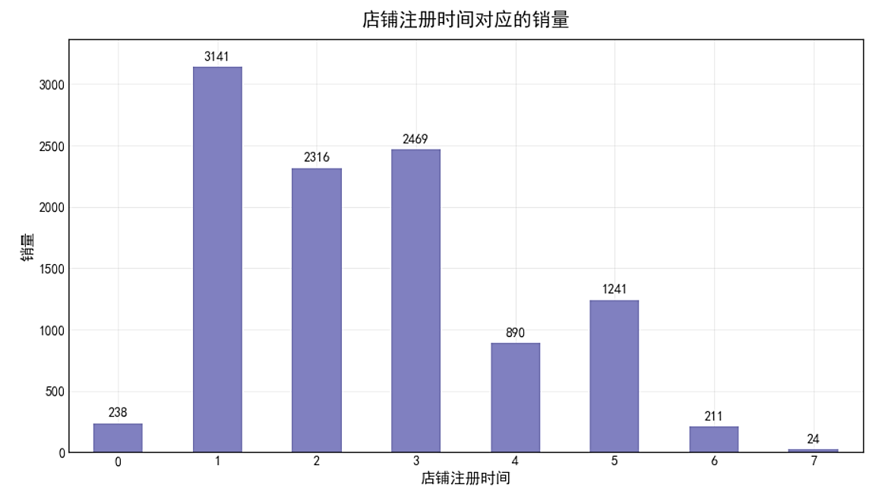
Data Analysis
Store Dimension
Stores that have been open for 1 to 3 years have more orders, and the purchase volume in 1 year of opening the store is the largest, followed by 3 years and 2 years, users buy more orders in stores with a store score of 9.2-9.8, of which merchants with a rating of 9.4-9.6 have the most purchase behavior. Analysis: Users prefer to buy in stores that have been open for 1 to 3 years, and think that the store rating of 9.4-9.6 is a store with better product quality.

Slide 16
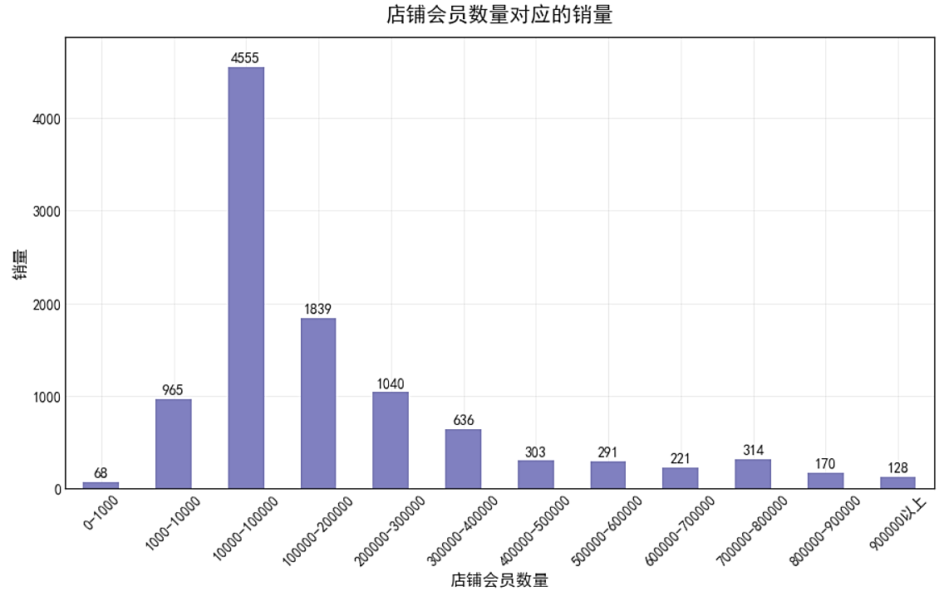
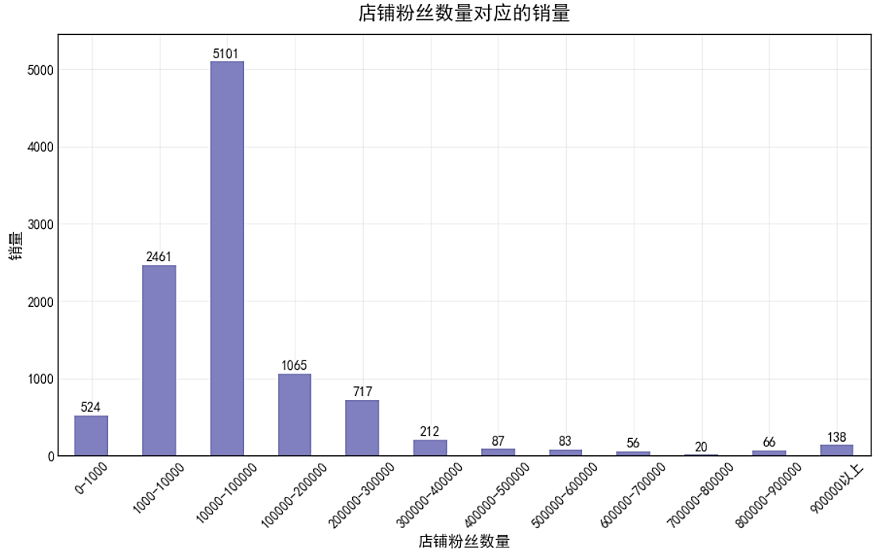
Data Analysis
Store Dimension
Among the merchants with 10,000-100,000 fans and members, users placed the most orders and purchases. Analysis: Users prefer to buy in stores with 10,000-100,000 fans and members, because users prefer stores that have been open for 1-3 years, and the number of fans and members is not too high.

Slide 17
Project Summary
Store Dimensions
User Dimension
Product Dimension
Stores in the beauty, food, and clothing categories sell the most. Users prefer to buy in stores that have been open for 1 to 3 years, and think that a store rating of 9.4-9.6 is a store with better product quality. Users prefer to buy from stores with a high number of followers and members.
Summary of Data Analysis
The food, clothing, beauty, jewelry, and household appliance brands promoted by the platform accounted for 80% of all brand sales. The Lipton tea brand is the most popular. The products with the best repurchase among the products are Coat, Tea, and the most interested is tea, male users have increased skin care awareness, and female users prefer cosmetics.
Time Dimension
The number of male users is almost twice as high as that of female users. The purchase level with membership level 1 is the highest. Most of the user's city levels are 3, 4, age groups 5, 6, city levels 4 and age 5 have the highest purchase levels. Male users almost all have higher purchases than women, but the gap is not very large.
Festive offers can encourage a large number of users to place orders; The suspension of logistics and the unstable operation of the platform during the Spring Festival affected user use and caused a decline in the number of orders; The platform did not do a good job of accurately pulling new products, and the promotion effect was not good. Thursdays, Fridays and weekends, 10 a.m. and 2 to 4 p.m., 8 p.m. to 10 p.m. are active times and high foot traffic. Most of the products recommended by the platform are not liked or required by users, and customers who add to the shopping cart have a strong desire to buy, and users have the desire to evaluate after purchasing.

Slide 18
Project Summary
Suggestions and Comments
The platform is well maintained, and logistics services are best guaranteed to operate throughout the year. When promoting the platform, focus on the two age groups of 5 and 6 for advertising, activity drainage, accurate recruitment, but also can attract some other age groups to ensure that the user group is more diverse. Put products on the shelves during the time when users are active, and make some special offers on holidays to stimulate user consumption. For male and female users, push different products, the platform needs to increase the number of female users, and at the same time improve the consumption level of male users. The platform needs to maintain more old users, and can ensure the stickiness of users in the form of old user welfare feedback, for new users, push some products according to interests, and push products to users in time with price reductions, new products, activities, etc., to bring users more experience.
Platform revenue is too concentrated in the main category, for some new categories, Jingdong Mall should give appropriate subsidies and support to achieve the diversified development of all categories, so that different consumers can buy the products they want. Lipton tea repurchase is very good, can be promoted for a long time, the number of male users who buy beauty has increased, and the platform can also sell some beauty products suitable for male users. The conversion rate of browsing to purchase is low, but the conversion rate of adding purchase to purchase is very high, the platform can do as many activities as possible, new competing products attract customers, guide customers to add to the shopping cart, and increase the number of purchases.

Slide 19
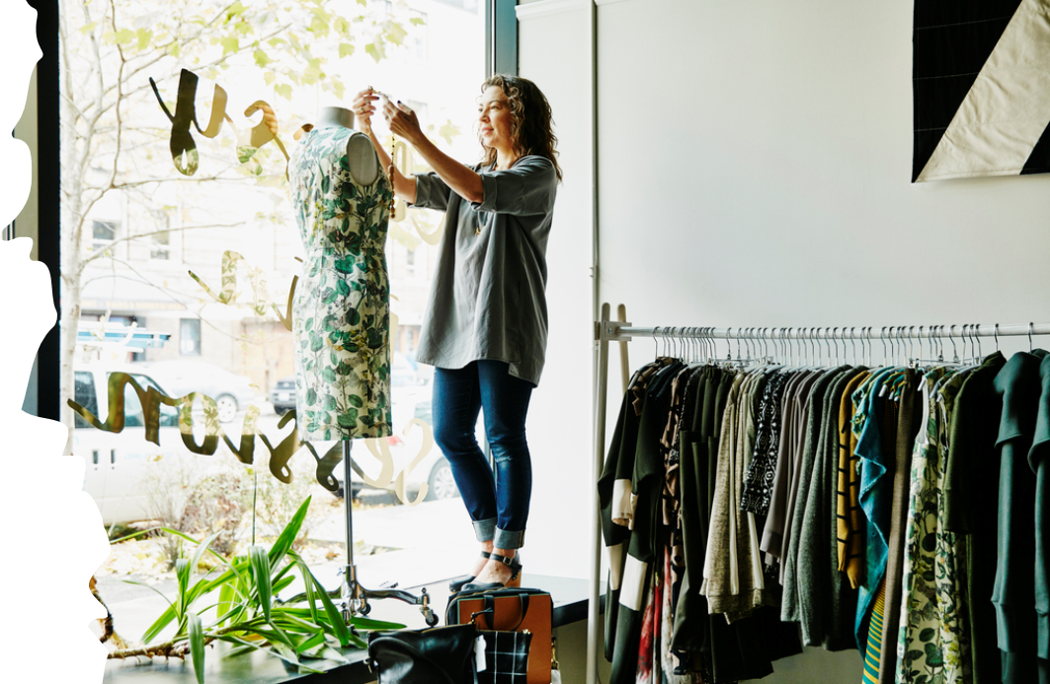

谢谢

